Slide 1
Search.com
Search| Website Design, Support, Management Services for Smart Businesses
Search
By
Avinash Ranjan

Slide 2
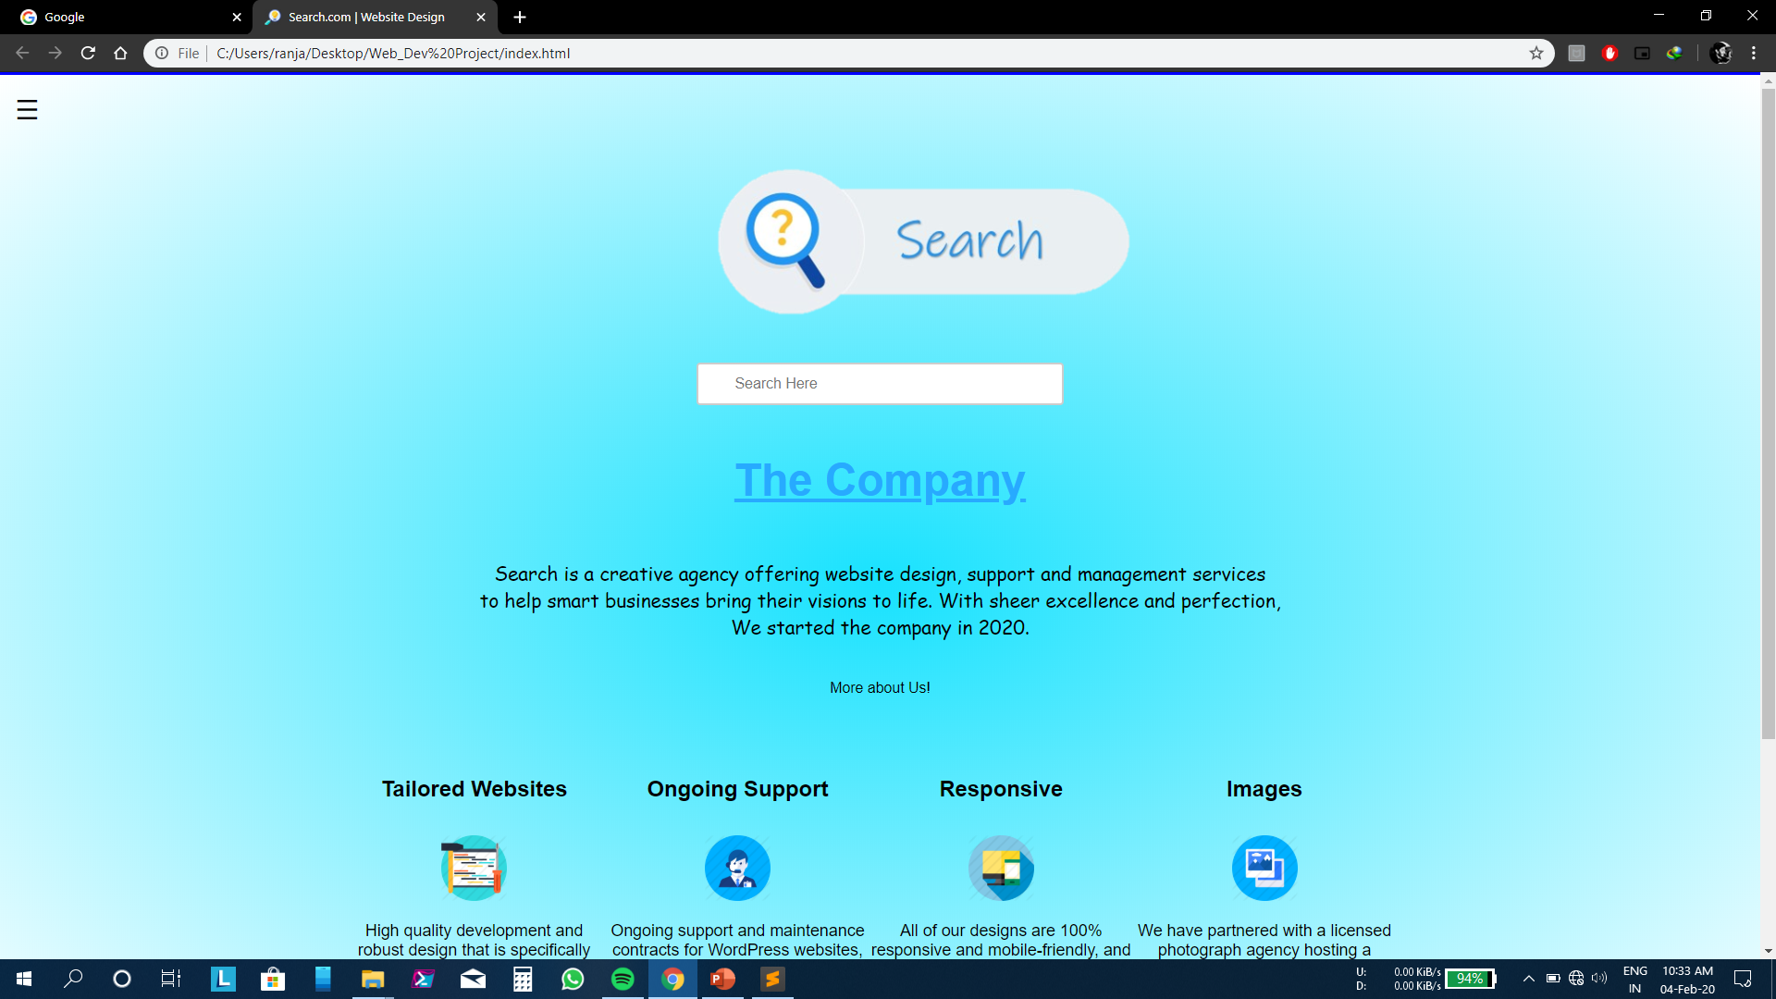

Slide 3




LANGUAGES USED
Hypertext Markup Language (HTML) is the standard markup language for documents designed to be displayed in a web browser. It can be assisted by technologies such as Cascading Style Sheets (CSS) and scripting languages such as JavaScript.
Cascading Style Sheets (CSS) is a style sheet language used for describing the presentation of a document written in a markup language like HTML. CSS is a cornerstone technology of the World Wide Web, alongside HTML and JavaScript.
JavaScript is a high-level, just-in-time compiled, multi-paradigm programming language that conforms to the ECMAScript specification. JavaScript has curly-bracket syntax, dynamic typing, prototype-based object-orientation, and first-class functions.
jQuery is a JavaScript library designed to simplify HTML DOM tree traversal and manipulation, as well as event handling, CSS animation, and Ajax. It is free, open-source software using the permissive MIT License. As of May 2019, jQuery is used by 73% of the 10 million most popular websites

Slide 4
Website Features
Tailored Websites
High quality development and robust design that is specifically tailored to suit your business needs, because every business is unique and so should be its website.
Images
We have partnered with a licensed photograph agency hosting a catalog of numerous alluring and beautiful images, all captured and retouched for your business.
Tailored Websites
Images
Ongoing Support
Responsive
Responsive
All of our designs are 100% responsive and mobile-friendly, and are easy to use on smartphones and tablets. We focus on delivering solutions that work for your business..
Ongoing Support
Ongoing support and maintenance contracts for WordPress websites, from plugins to core updates, and monitoring, we have your website covered.

Slide 5
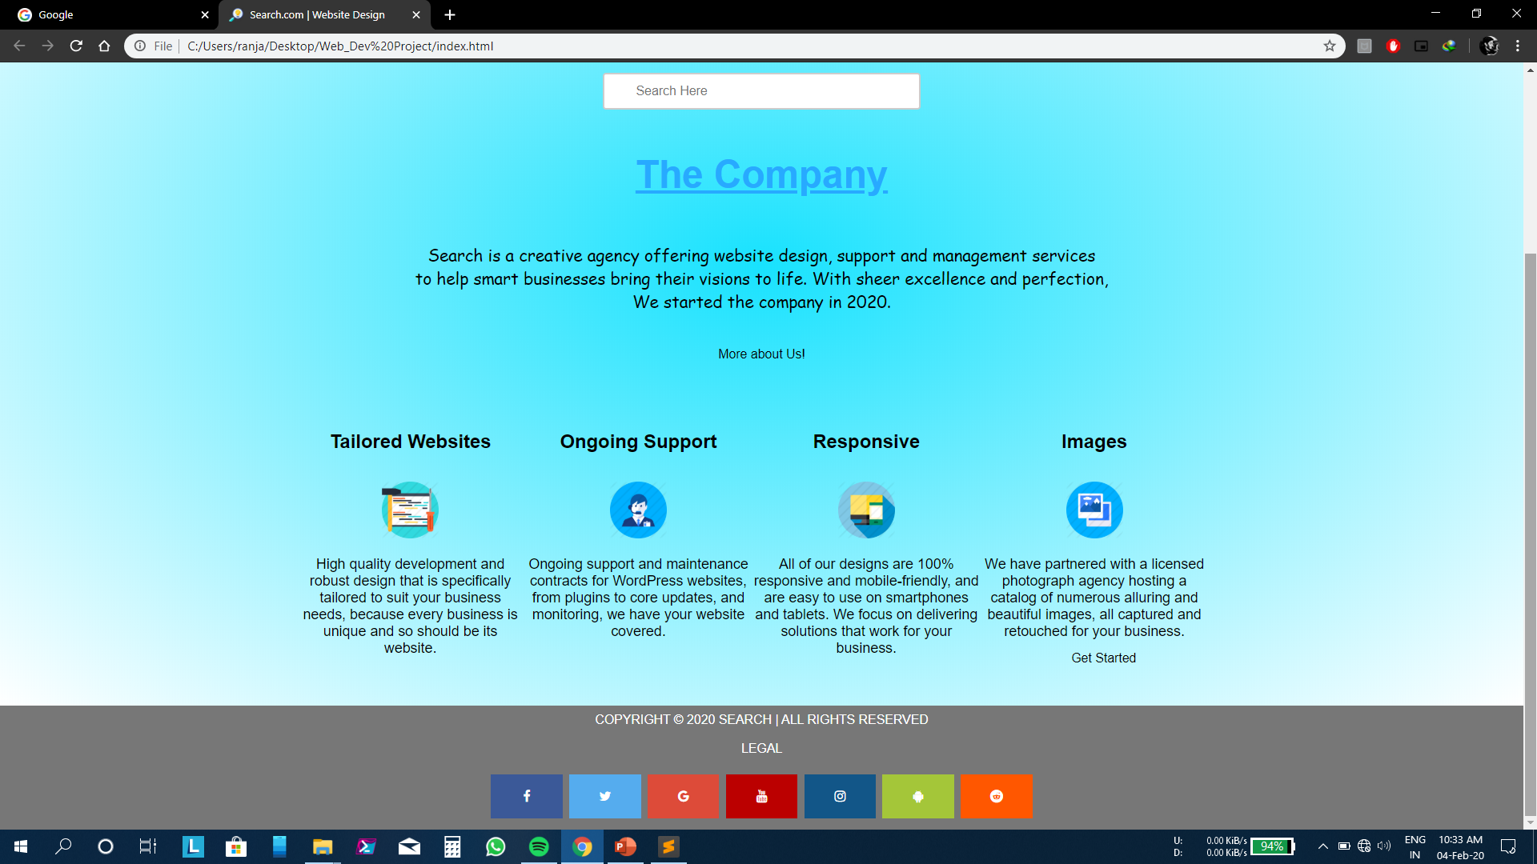

Slide 6
The Company
Search is a creative agency offering website design, support and management services to help smart businesses bring their visions to life. With sheer excellence and perfection, We started the company in 2020.
More About Us
Our team understands your need to develop a unique solution that enhances your brand position. We are just about the right size for our mighty clients and because of our right size; our team is able to dedicate themselves passionately to projects. The right size allows us to be dexterous, fast and adaptive.
Website for Personal Use.
Websites for Professional Use.
Websites for Business
With New Clients getting added every day. We are growing rapidly.
Search.com
Search.com
Search.com

Slide 7
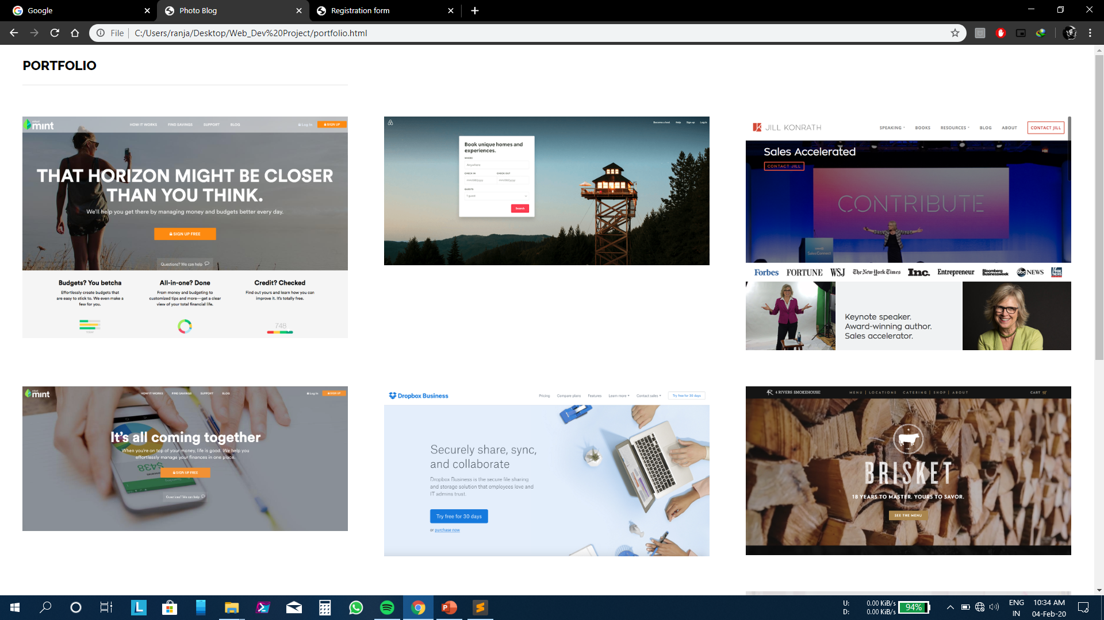

Slide 8
Services We Offer
Design
Our developers know their way around the World's most powerful CMS, they thrive on these platforms. Whether it is a new project or an ongoing project, our developers are here to expand their horizon to size all your needs in one elegant, powerful, responsive website. Our code is based on latest industry best practices.
Migrations
Support
Our experts analyze your website content and it's usage, and if something doesn't look, feel, or sound right, our migration services are here to save our clients from all the hassle. We migrate your existing{ website to a new server without a glitch. Because the front end is meant to be (server) error free.
A simple support can go a long way for a complex project, and that's why we're here; to offer you fanatical support. Let us take care of your website just like you do. Our ongoing support includes complete maintenance, core updates, and performance monitoring of your website..
Strategy
Every business is unique, and we like to get started by knowing the little aspects that make your business stand out from the crowd. We research about your business, and the market that you compete in, and we open new opportunities to you to help you expand your business.

Slide 9
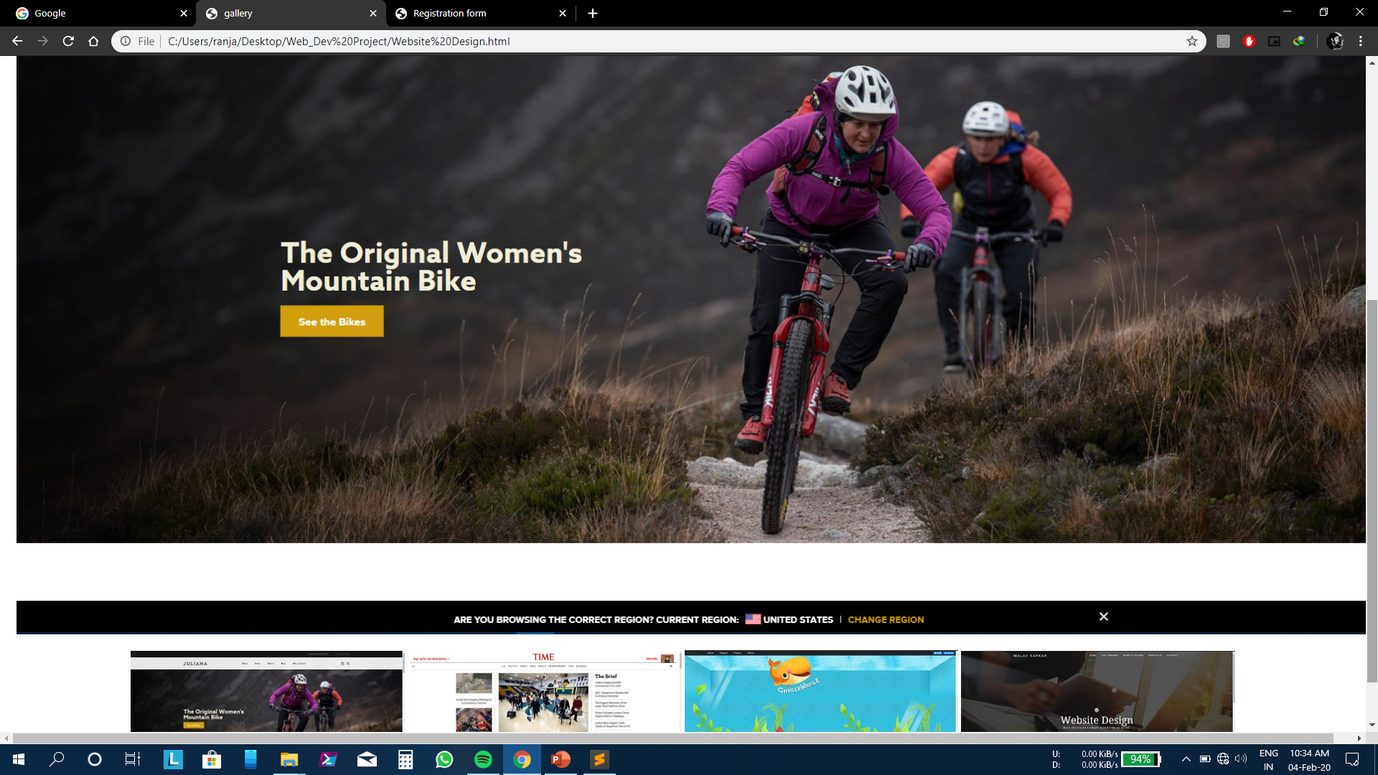

Slide 10
Ask Us To
Build Website
Fast
Supportive
Responsive
We can build your website as per your needs in minimum time.
We will always be there for you and to solve your problems.
All the website built by us will be responsive on every device.

Slide 11
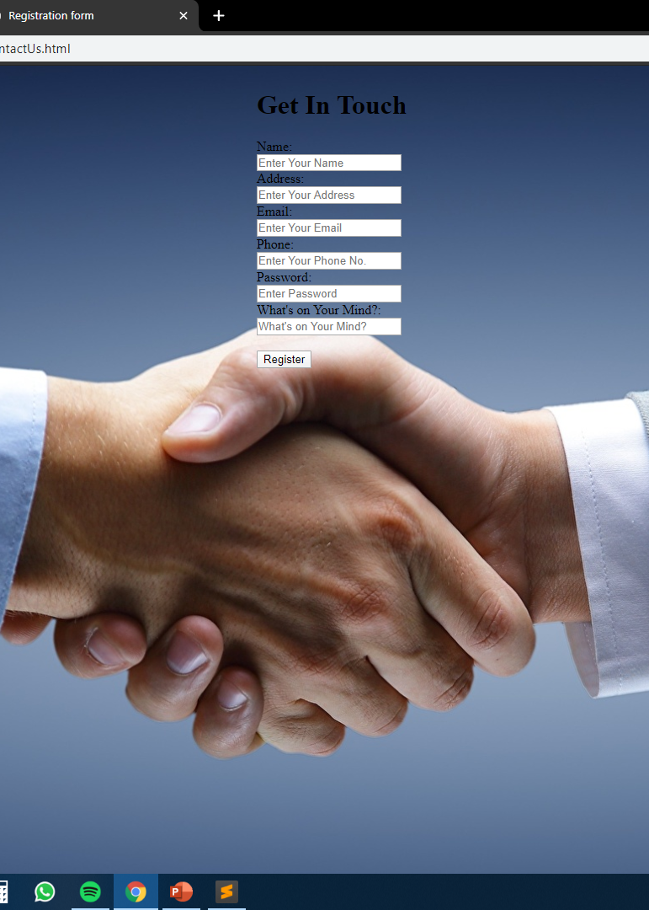
Visit Us
And
Register with us
And we will always be there for all your website needs

Slide 12
A Visit to our Website
1
Responsive on All Devices
Link Here

Slide 13
THANK YOU

